Slide 1
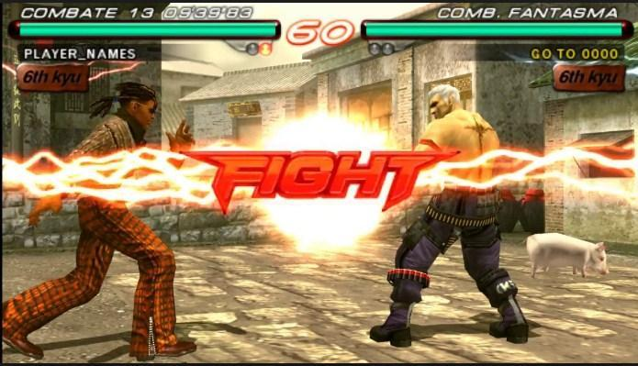
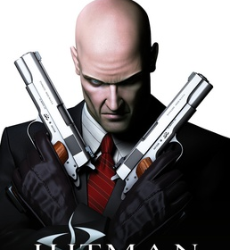
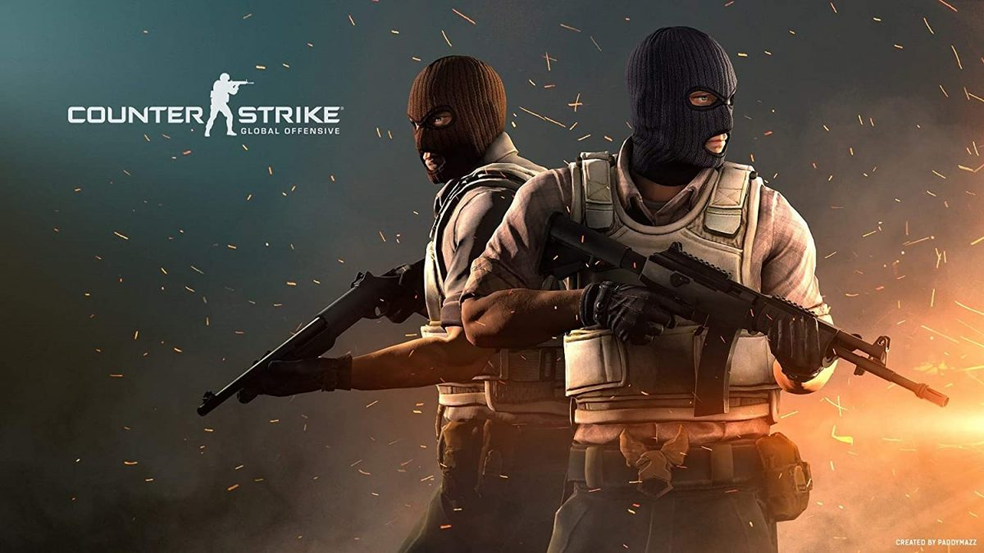

CS-443
Game Design and Development

Slide 2
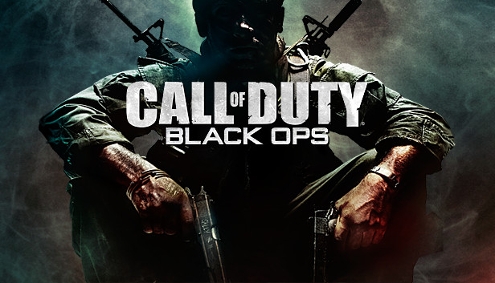
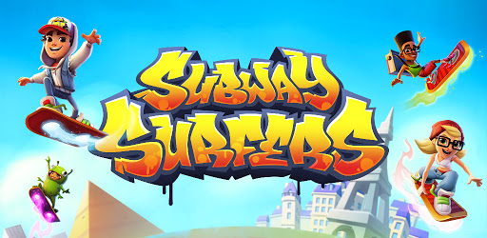
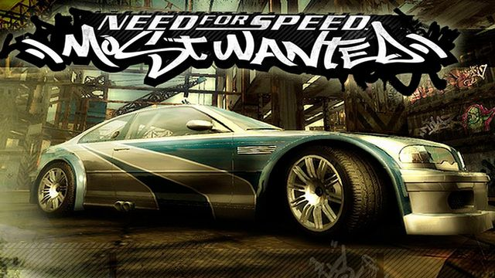
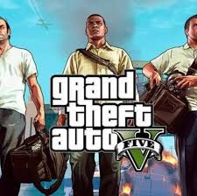
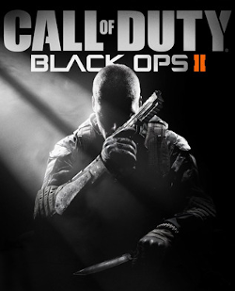
Game Designs

Slide 3
What is Game?
Game is one of the source of entertainment

Slide 4
What is Game?
Definition:
A structured form of play or activity, often undertaken for enjoyment, challenge, or educational purposes, involving rules, objectives, and interactions between players or between players and the game environment
Key elements that make up a game include:
Rules: Guidelines that govern the gameplay, setting limitations and objectives.
Objectives: Goals that players strive to achieve, such as winning, completing a task, or reaching a high score.
Interaction: Players interact with the game, other players, or the game environment.
Challenge: The difficulty or obstacles that players must overcome to achieve the objectives.
Feedback System: Provides players with information about their progress, often in the form of scores, levels, or visual indicators.
While games are indeed a form of entertainment, they can also serve other purposes, such as learning, social interaction, or developing skills.

Slide 5
What is Design?
Design refers to the process of creating the overall structure, mechanics, rules, and experience of a game.
It involves conceptualizing how the game will function, how players will interact with it, and what emotions or experiences it aims to evoke.

Slide 6
Development
Coding (C#)

Slide 7
Gamers
Our Client
People who play games

Slide 8
Team behind Games
Game developer
Artist
Animator
Designer
Audio Engineer and Composer
Tester
Project Manager a.k.a Producer

Slide 9
Team behind Games
Game developer/Programmer
Create logic
Write code for game features and functionality
Environment programmer
AI programmer

Slide 10
Game Developer/Programmer
Role: Responsible for designing, developing, and implementing the core mechanics and functionality of the game.
Tasks:
Create game logic that defines how different aspects of the game will behave.
Write and optimize code to implement game features like player movement, scoring, physics, and more.
Collaborate with other developers, designers, and artists to integrate various game components.

Slide 11
Environment Programmer
Role: Focuses on creating and optimizing the game’s world and environment.
Tasks:
Develop tools and systems for generating and managing in-game environments, such as landscapes, buildings, and interactive objects.
Ensure that the environment interacts properly with the game mechanics (e.g., physics, lighting).
Work on creating dynamic environments that can change based on the player's actions or game events.

Slide 12
AI Programmer
Role: Develops the artificial intelligence that governs the behavior of non-player characters (NPCs) or enemies.
Tasks:
Design algorithms that control NPC behavior, making them react realistically to player actions or other in-game events.
Implement pathfinding techniques to enable characters to navigate the game world.
Develop decision-making systems to simulate intelligent behavior in NPCs.
These roles are integral to the game development process, ensuring that the game is functional, interactive, and engaging.

Slide 13
Team behind Games
Artist
How the game should look like
character model
character e.g. Player artist
Level artist

Slide 14
Artist
Role: Responsible for the visual aspects of a game. They create the artwork, models, textures, and animations that determine how the game looks and feels.
Tasks:
Work on creating characters, environments, user interfaces, and visual effects.
Collaborate with game designers and programmers to ensure the art aligns with the game's vision and gameplay requirements.
Use various tools and software for 2D and 3D art creation, such as Photoshop, Blender, Maya, or 3ds Max.

Slide 15
Character Artist
Role: Focuses on creating the visual design and 3D models for characters in the game, including the main player, enemies, NPCs, and creatures.
Tasks:
Design characters based on the game’s concept and style, ensuring they fit within the game's universe.
Sculpt and model character details, such as facial features, clothing, armor, and accessories.
Apply textures, materials, and colors to give the character a finished appearance.
May also be involved in rigging (adding a skeleton for animation) and creating character animations.

Slide 16
Player Artist
Role: Specializes in creating the main character(s) or avatars that players will control.
Tasks:
Focus on the details of the player's character, including different outfits, weaponry, and movement animations.
Work closely with animators to ensure that the player's movements look natural and realistic.
Update the player character's design to accommodate new features or changes during development.

Slide 17
Level Artist
Role: Responsible for designing and creating the visual elements of the game’s levels or environments.
Tasks:
Build 3D models and textures for terrain, buildings, foliage, and other environmental assets.
Arrange and place assets in the game world to create visually appealing and functional levels.
Work with level designers to ensure the environments support gameplay mechanics and objectives.
Add visual details like lighting, shadows, and effects to enhance the overall atmosphere of the level.
These different types of artists bring the game world to life, creating a visually engaging experience that supports the story and gameplay.

Slide 18
Team behind Games
Animator
They create movement for characters
Player (Idle, walking, running, dying etc.)
Designer
How the player will play the game?
player mechanics
level design
create game designer document

Slide 19
Animator
Role: Responsible for creating the movement and animation for characters, objects, and other visual elements in the game.
Tasks:
Animate characters, including player characters, NPCs, and creatures, with different actions such as idle, walking, running, jumping, attacking, and dying.
Work on animating environmental elements, like trees swaying or doors opening, to make the game world feel more dynamic.
Use animation software (e.g., Maya, Blender, 3ds Max) to create keyframes or motion capture animations.
Collaborate with character artists and designers to ensure the animations are fluid and fit well within the game's style and mechanics.

Slide 20
Designer
Role: Designers are responsible for conceptualizing and creating the core aspects of how the game will be played and experienced.
Tasks:
Player Mechanics: Define how the player will interact with the game, such as controls, abilities, combat systems, and progression.
Level Design: Create the layout and flow of game levels, including objectives, challenges, puzzles, and enemy placements to ensure an engaging player experience.
Game Design Document (GDD): Write a detailed document outlining the game's vision, mechanics, story, characters, art style, levels, and technical requirements. The GDD serves as a blueprint for the entire development team.
Gameplay Balance: Ensure that the game’s difficulty, rewards, and player progression are balanced to provide a satisfying experience.
Prototyping: Test new mechanics or level layouts in early stages to refine the design before full implementation.

Slide 21
Team behind Games
Game developer
Artist
Animator
Designer
Audio Engineer and Composer
Tester
Project Manager a.k.a Producer

Slide 22


Game Engine

Slide 23
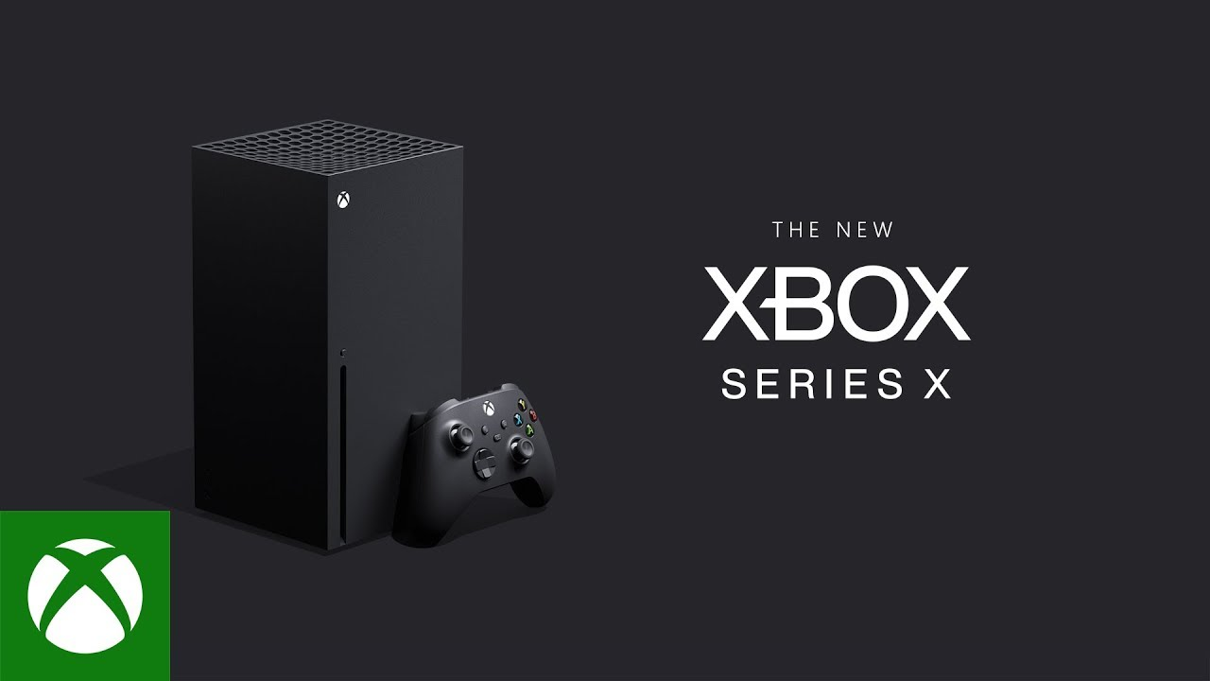
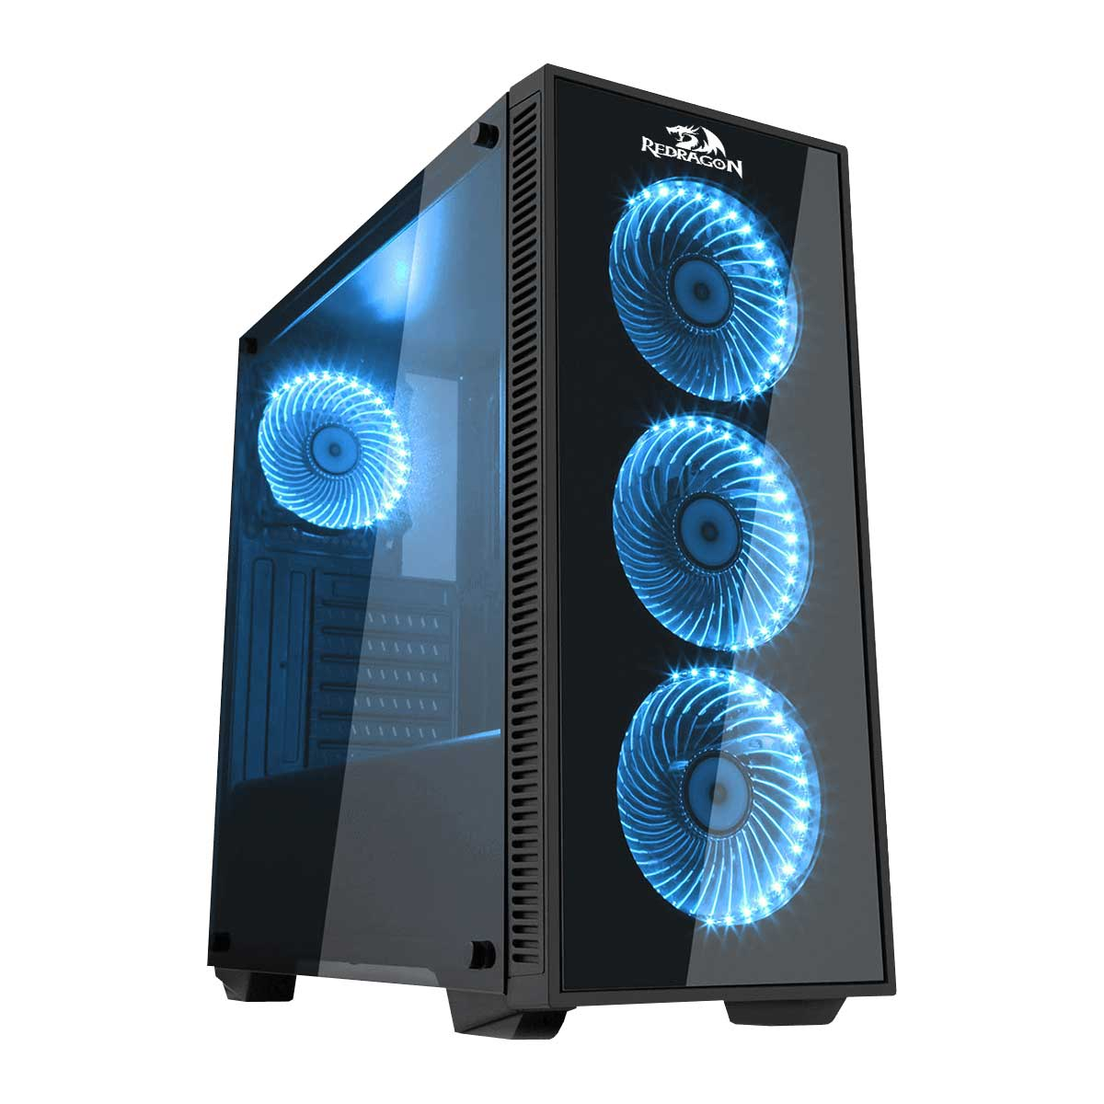


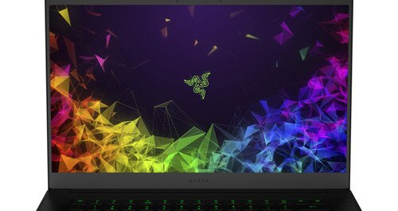
Platforms

